Slide 1

Predicting Customers Likelihood on Loan Repayment
Theophilus Ebode

Slide 2
Outline
Objective
Models used
Metrics for evaluating the models
Explanation of model
Findings
Recommendations
Appendix

Slide 3

Objective
To develop a predictive model to predict the likelihood of customers paying back their loans.

Slide 4
Models used
Model 1 : Gradient Boosted Decision Tree
Model 2: Random Forest
Model 3: Decision Tree

Slide 5
Metrics used for evaluating the models
Accuracy
Precision
Recall
Confusion matrix
F1-score

Slide 6

Accuracy

Slide 7

Accuracy...
Accuracy measures how well the model can correctly predict the outcome of a loan repayment. It represents the percentage of correct predictions made by the model. In other words, it shows how often the model is correct in predicting whether a customer will repay their loan or not.

Slide 8

Precision

Slide 9

Precision...
Precision is a metric that helps us evaluate the accuracy of our model in predicting positive outcomes. In the case, positive outcome is a customer who repays their loan. It helps identify the number of true positives (i.e., customers who actually repaid their loan and were correctly identified by the model.

Slide 10

Recall

Slide 11

Recall...
Recall identifies all the positive instances
(in this case, customers who will repay
their loans) out of all the actual positive
instances. For example, if there are 100
customers who can repay their loans, the
result of 'recall' shows how many were
identified from the 100 customers

Slide 12

F1-score

Slide 13

F1-score...
F1-score combines both precision and recall to provide a balanced measure. It takes into account both how accurately the model identifies positive cases and how well it identifies all positive cases.
The F1-score in our case, combines both how accurately the model identifies positive cases (customers who will repay back their loans) and how well it identifies all positive cases.

Slide 14

Confusion matrix

Slide 15
Confusion matrix ...
Confusion matrix shows how often our predictions are correct and incorrect predictions. By looking at the numbers in each quadrant, we can calculate different metrics that tell us more about the model's strengths and weaknesses.

Slide 16
Confusion matrix...
True Positive (TP): The model correctly predicted that a customer will repay their loan.
2
False Positive (FP): The model predicted that a customer will repay their loan, but in reality, they did not.
3
True Negative (TN): The model correctly predicted that a customer will not repay their loan.
4
False Negative (FN): The model predicted that a customer will not repay their loan, but in reality, they did.
The confusion matrix is divided into four quadrants, which represent different types of predictions that the model can make:
1

Slide 17
Explanation of the confusion matrix
The preferred model was able
to correctly identify 3766
customers who can repay
their loans. This represents
94% of the customers who
can truly repay their loans.

Slide 18

Challenge about the preferred model
It however incorrectly predicted that
258 customers would repay their loans
but in reality, these customers could
not.
This means that 6% of the customers we advanced loans to using this model would have been charged-off.

Slide 19

Evaluating the model using f1-score
The F1-score was used to evaluate
the model since it considers all cases
where customers can repay their
loans. As such the business does not
miss out on income opportunities
from customers while reducing incorrect predictions that can lead to financial losses
This Photo by Unknown author is licensed under CC BY-SA.

Slide 20
F1-score evaluation...
The f1-score of 94% for 'Fully paid' customers means that
the model correctly identified 94% of customers who are
likely to repay their loans (true positives), while
incorrectly classifying 6% of customers as likely to repay
when they won't (false positives).

Slide 21
F1-score evaluation
Also, the F1-score of 94% for '0' means that the model correctly identified 94% of customers who are likely not to repay their loans (true negatives), while incorrectly classifying 6% of customers as not likely to repay when they actually will (false negatives)

Slide 22

Explanation of the Preferred model
The model using Gradient Boosted
Decision Tree was selected because it
offers a better performance across
various metrics; accuracy, precision,
recall and f1-score compared to the other
models. Two different versions of the model was developed.

Slide 23

First version of the Gradient Boosted Decision Tree model
This version of the model was
developed using the top 10
most important features
identified in the data

Slide 24
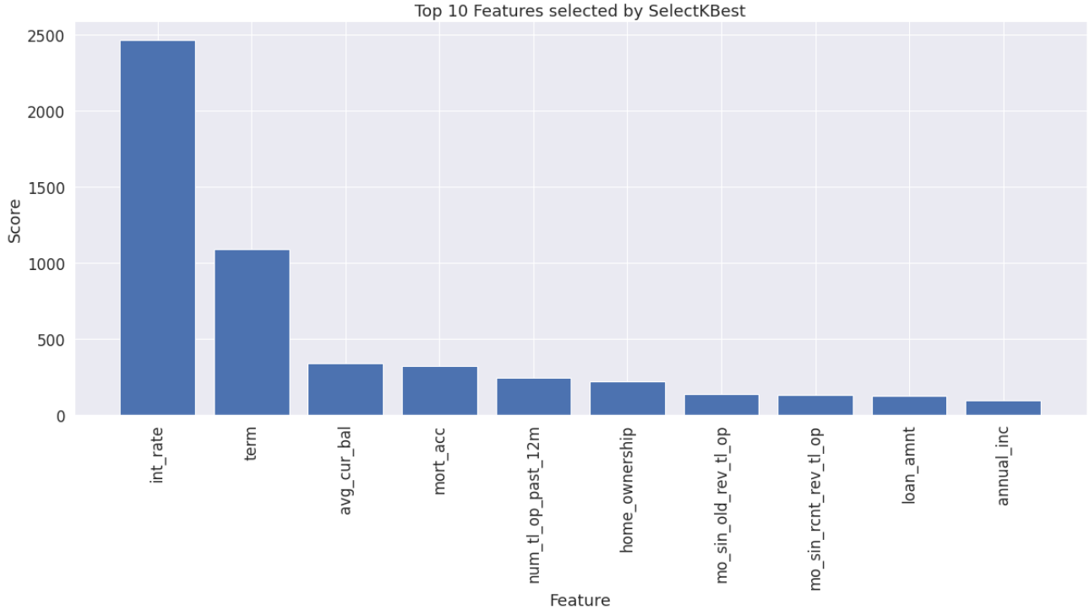
Top ten most important features identified from the data

Slide 25
Second version of the Gradient Boosted Decision Tree
The second version of the model was developed by introducing all the features of the data except the identity into the model. The top five most important features driving the model was extracted.
The f1-score of the first and second version is 93% and 94% respectively.

Slide 26
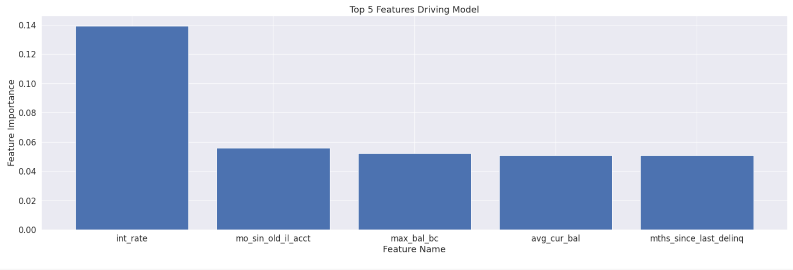
Top five features driving the second model

Slide 27

Findings
Some features affecting the number of customers that were offered loans and their repayment status

Slide 28
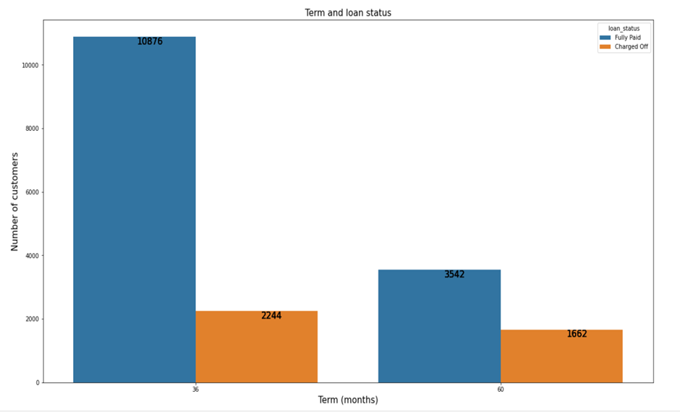
Relationship between term and probability of repaying back loans

Slide 29
Relationship between term and status of repaying back loans
82% of customers on 36 months term fully paid back their loans while 68% of customers on 60 months term fully paid back their loans. This shows that there is a lower probability for customers on 60 months term to fully pay back their loans.

Slide 30
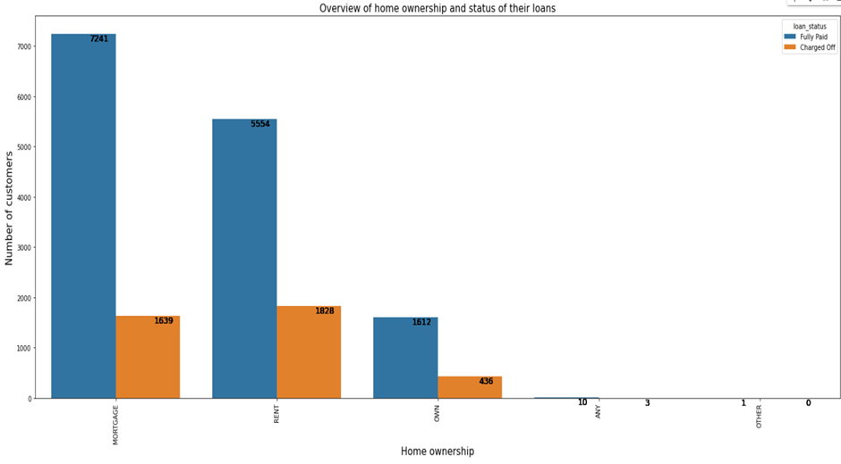
Relationship between home ownership and their status of repaying back loans

Slide 31

Relationship between home ownership and probability of repaying back loans
Customers whose homes were on mortgage records the highest 81% likelihood of fully paying back their loans. This is against 75% and 78% for customers on rent and ownership respectively.

Slide 32
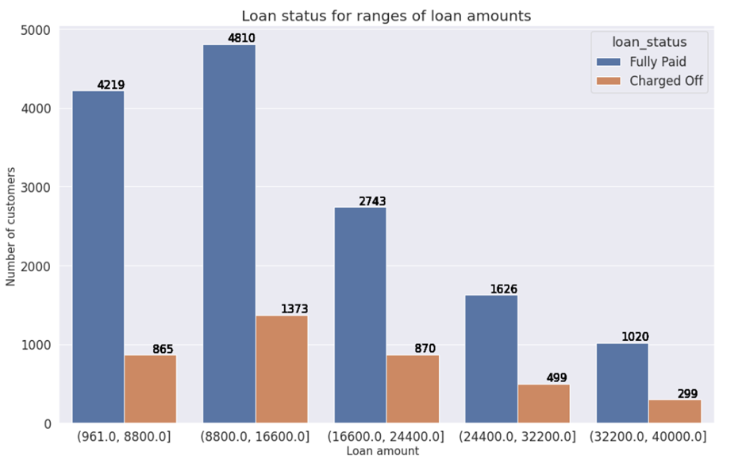

Slide 33
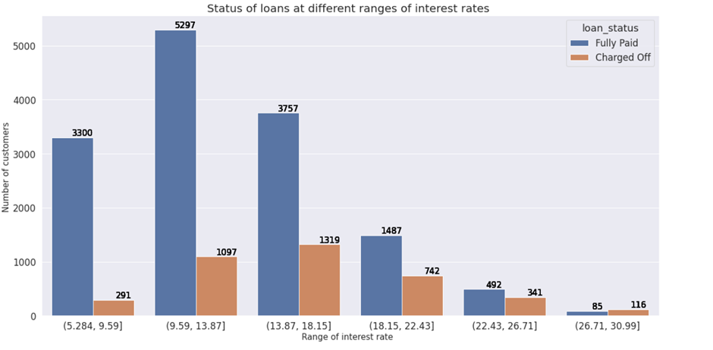
Repayment status at various ranges of interest rate

Slide 34

Recommendations
Lloyds bank should consider offering more 36 months term loans. Incentives or lower interest can be used to drive this offer.

Slide 35

Recommendations
The risk of 60 months term loans should be re-evaluated and only offered after considering the risk.
Targeted support like financial education, debt management can be offered to customers especially customers on 60 months term

Slide 36

Recommendations...
Customers whose home ownership status is on mortgage shows a lower risk of defaulting in loan repayment. More incentives or favorable loans can be advanced to them

Slide 37
Recommendation ...
Interest rate is a major consideration affecting loan repayment. Higher interest rates reduces the likelihood that customers will repay their loans.
Although this is dependent on other external factors such Creditworthiness, economic condition, inflation, loan term, monetary policies, lower interest rates should be considered for customers who are likely to repay their loans.

Slide 38
Appendix

Slide 39
Comparisons of top three models
Model / metric measurements | Gradient Boosted Decision Tree (%) | Random Forest (%) | Decision Tree (%)
Accuracy | 94 | 91 | 85
Precision 1 (Fully paid) | 93 | 95 | 94
Precision 0 (charged -off) | 94 | 88 | 79
Recall 1 (Fully paid) | 94 | 87 | 75
Recall 0 (charged -off) | 93 | 95 | 95
F1- score 1 (Fully paid) | 94 | 91 | 87
F1- score 0 (charged -off) | 94 | 92 | 84

Slide 40
Confusion matrix of top three models
 | TP | TN | FP | FN
Gradient Boosted Decision Tree | 3766 | 3787 | 266 | 258
Random Forest | 3512 | 3854 | 199 | 512
Decision Tree | 3020 | 3867 | 186 | 1001

Slide 41
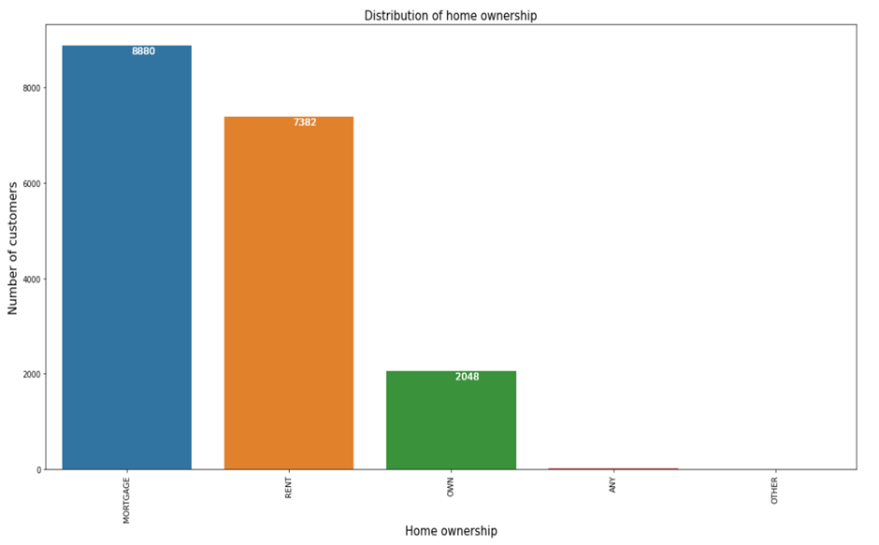
Home ownership status of customers on loan

Slide 42
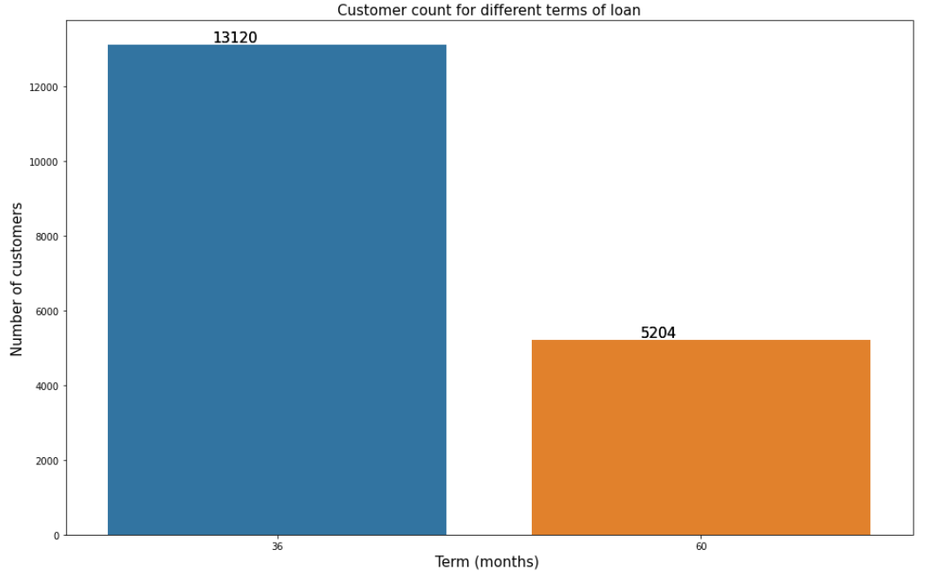
Customers loan profile based on the term

Slide 43
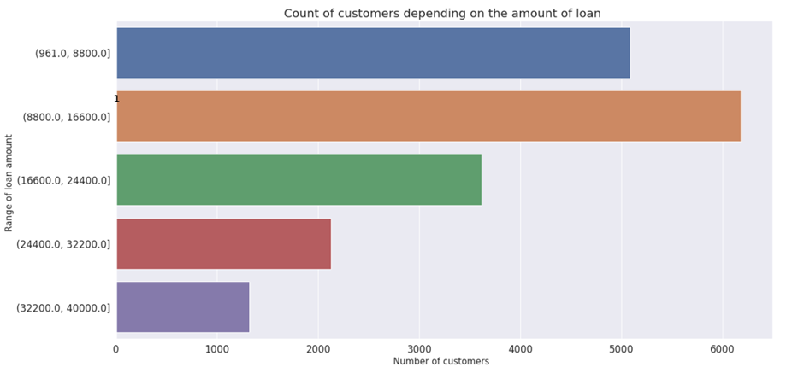

Slide 44
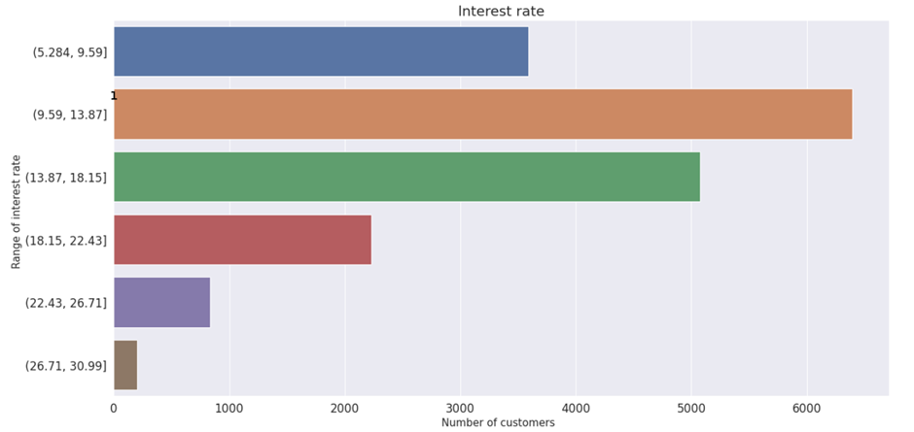

Slide 45
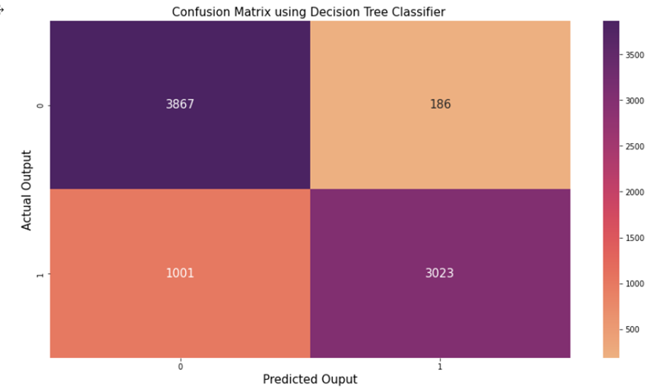

Slide 46
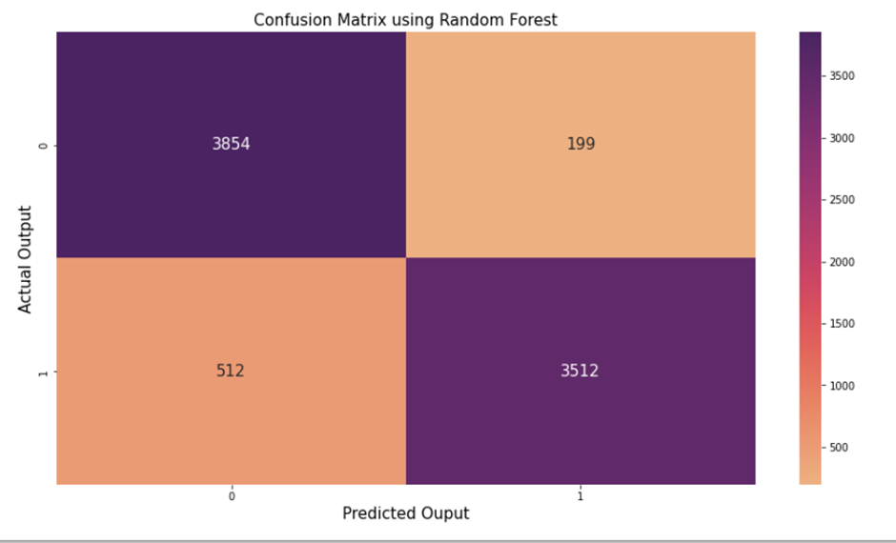

Slide 47
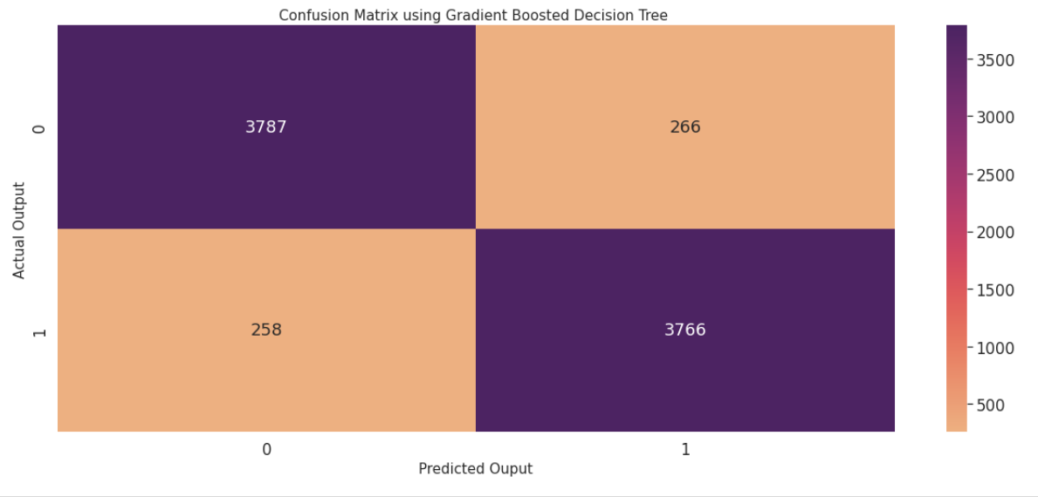

Slide 48
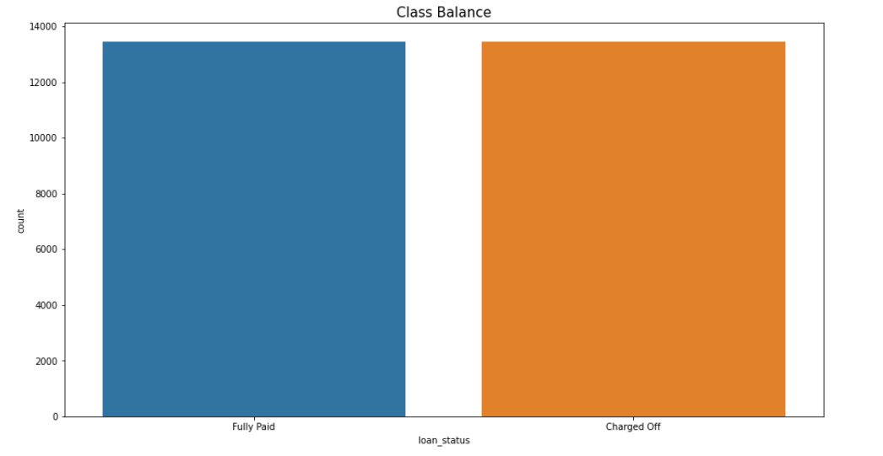
Balancing the class of loan status before developing the model

